Slide 1

Lecture 1: Introduction and review of key concepts: Loss functions and decision theory; forecast evaluation
Prof. Massimo Guidolin
Advanced Financial Econometrics III
Winter/Spring 2020

Slide 2
Overview
Generalities on forecasting
Mean squared, mean absolute, mean percentage forecast accuracy measures
The difference between statistical and economic loss functions
The recovery problem
Limitations of quadratic loss functions and location-dependent losses
Hints to forecast evaluation issues

Slide 3
Generalities
There are two key approaches to forecasting over time: structural vs. time series
Prediction or forecasting indicates an attempt to determine the values that a series is likely to take in the future
  Forecasts might also usefully be made in a cross-sectional environment but this is more rarely seen
Determining the forecasting accuracy of a model is an important test of its adequacy
Some econometricians would go as far as to suggest that statistical adequacy of a model in terms of whether it contains insignificant parameters, provides a poor fit etc.
Two approaches to forecasting:
  ① Econometric (structural) forecasting -- relates one or more dependent variable to one or more explanatory variables
  Such models often work well in the long run, when a relationship between variables arises from no-arbitrage or market efficiency

Slide 4
Generalities
Forecasts can be point and interval forecasts, in- and out-of-sample
  ② Time series forecasting -- predicting the future of a series given its previous values and/or previous values of an error term
  The distinction between the two types is somewhat blurred -- for example, it is not clear where VAR models fit
Point forecasts predict a single value for the variable, while interval forecasts provide a range of values in which the future value of the variable is expected to lie with a given level of confidence
In-sample forecasts are those generated for the same set of data that was used to estimate the model’s parameters
  One would expect the ‘forecasts’ of a model to be relatively good in-sample, for this reason
  Therefore, a sensible approach to model evaluation through an examination of forecast accuracy is not to use all of the observations in estimating the model parameters…
  … but rather to hold some observations back (holdout sample)

Slide 5
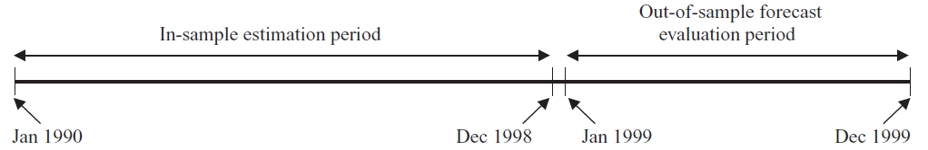
Generalities
Forecasts can be in- and out-of-sample
True (possibly) genuine out-of-sample (OOS) forecasts are those generated for data not used in estimation
  This includes pseudo OOS forecasts, when estimates are not conta-minated by data used in assessing the forecasts but some elements of model specification or selection may be based on the full sample
  Typically, pseudo OOS exercises are recursive
  OOS may be applied cross-sectionally, e.g., I estimate the ICAPM premia on N securities and see whether these price other, M securities
  However, more commonly OOS exercises are time series in nature
  E.g., use data from 1990M1 until 1998M12 to estimate the model parameters, and then the observations for 1999 would be forecasted from the estimated parameters

Slide 6
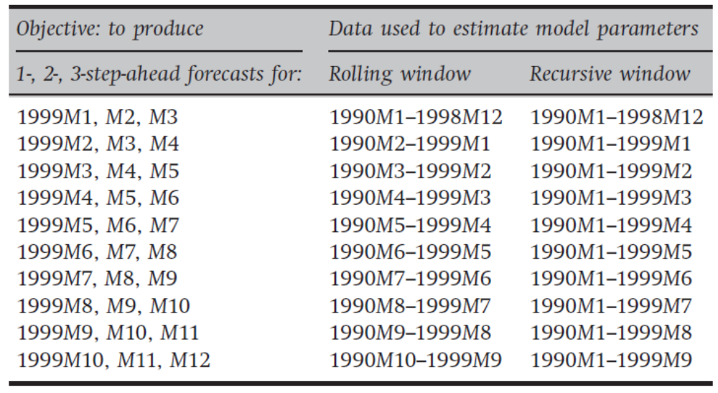
Generalities
Forecasts can be one- vs. multi-step ahead, rolling vs. expanding
A one-step-ahead forecast is a forecast generated for the next observation only, whereas multi-step-ahead forecasts are those generated for 2, 3, . . . , H steps
  When H is large enough, given a sample of T observation, a researcher would then lose T – H observations, because the last H-step ahead forecasts cannot be compared to any data
A way around the problem is a recursive implementation
A recursive expanding
model is one where the
initial estimation date is
fixed, but additional obs.
are added one at a time
A rolling window is one
where the length of the in-
sample period to estimate
is fixed

Slide 7
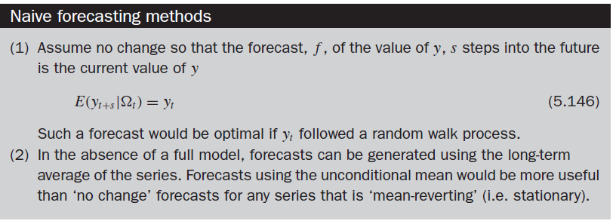
Generalities
Optimal forecasts often coincide with conditional expectations
  The start date and end date successively increase by one observation
How do we construct forecasts? There is no specific rule: as we shall see, it depends on loss functions and econometric models how “optimal forecasts” may be obtained
One key idea in the literature: conditional expectations!
E[Y_{t+h}|_{t}] = E[Y_{t+h}|I_{t}] = E_{t}[Y_{t+h}] (when content of _{t} /I_{t} is clear)
  Imporant note: this is true only for specific loss functions!
Often optimal
forecasts are
compared to
benchmarks, e.g.,
the random walk
and unconcond.
mean (historical
sample average)

Slide 8
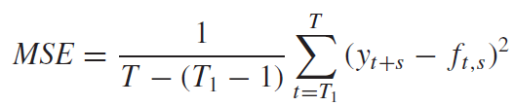
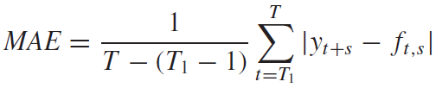
Generalities
The mean squared forecast error (MSE) and mean absolute error (MAE) are the two key measures of predictive accuracy
In practice, forecasts would usually be produced for the whole OOS period and then compared with the actual values
  The differences between them, forecast errors, are then aggregated
  The forecast error for observation i is defined as the difference between actual value for observation i and the forecast made for it
Because the forecast error will be positive (negative) if the forecast was too low (high), it is not possible to simply sum the forecast errors, since the positive and negative errors will cancel out
Before the forecast errors are aggregated, they are usually squared or the absolute value taken, which renders them all positive
Little can be gleaned from considering MSE or MAE because they are unbounded from above

Slide 9
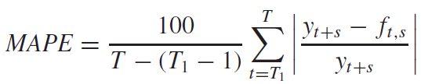
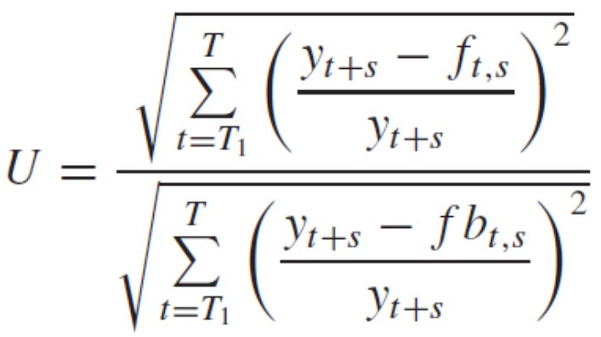
Generalities
Theil’s U-statistic assess relative predictive accuracy
  Normally, MSE or MAE from one model would be compared with those of other models for the same data and forecast period
  Mean absolute percentage error (MAPE) is a relative measure:
Another criterion which is popular is Theil’s U-statistic (1966), where fb_{t,s} is the forecast obtained from
a benchmark model (e.g., a simple
model such as a naive or random walk)
A U-statistic of one implies that the
model under consideration and the
benchmark model are equally (in)accurate
A value of less than one implies that the model is superior to the benchmark, and vice versa for U > 1
However, if fb_{t,s} is the same as y_{t+s} , U will be infinite

Slide 10
Statistical vs. Economic Loss Functions
Often statistical measures of predictive accuracy poorly correlate with economic measures, such as trading profits
Many econometric forecasting studies evaluate the models’ success using statistical loss functions
It is not necessarily the case that models classed as accurate because they have small MSFE are useful in practical situations
  We have many examples that the accuracy of forecasts according to traditional statistical criteria may give little guide to the potential profitability of those forecasts in a market trading strategy
  Models that perform poorly on statistical grounds may still yield a profit if used for trading, and vice versa
Models that can accurately forecast the sign, or can predict turning points have been found to be more profitable, i.e., to perform best in terms of economic loss functions (Leitch and Tanner, 1991, AER)
  Two possible indicators of the ability of a model to predict direction changes irrespective of their magnitude are those suggested by Pesaran and Timmerman (1992, JBES) and by Refenes (1995, JFor)

Slide 11
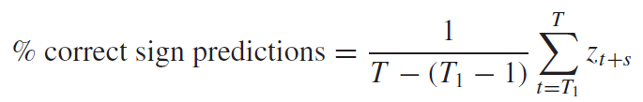
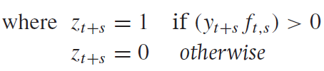
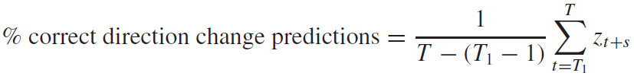

Economic Loss Functions
The mean percentage proportions of sign predictions is a measure that often associates with economic measures
  The relevant formulae are, respectively:
  In each case, the criteria give the proportion of correctly predicted signs and directional changes for some lead time s, respectively
  There exist forecasters who may be operating independently so that forecasts are produced and there are several potential users
A decision maker will typically have a payoff or utility function U(x, α), which depends upon some uncertain variable or vector x which will be realized and observed at a future time T

Slide 12
Economic Loss Functions: The Set-Up
The variable or vector α is a decision variable which must be chosen out of a set A at some earlier time t < T
  For instance, x  X ⊂ R¹ and α  A ⊂ R¹ after the forecast is learned, but before x is realized
The decision maker can base her choice of α upon a current scalar forecast (a “point forecast”) x_{F} of the variable x, and make the choice α(x_{F} ) ≡ argmax_{α∈A}U(x_{F}, α)
Given the realized value x_{R}, the decision maker’s ex post utility
U(x_{R}, α(x_{F})) can be compared with the maximum possible utility they could have attained, namely U(x_{R}, α(x_{R}))
This shortfall can be averaged over a number of such situations, to obtain the decision maker’s average loss in terms of foregone utility
U(x, α(x)) does not necessarily correspond to a standard statistical metrics, such as RMSFE
  E.g., if one forecasting method has a lower (or zero) bias but higher average squared error than a second one, clients with different goals or preferences may disagree on which of the two techniques is “best”

Slide 13
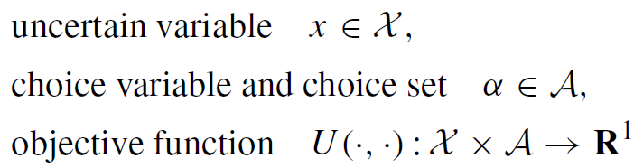

Economic Loss Functions: The Set-Up
A decision problem consists of the following components:
For point forecasts, the decision maker’s optimal action function α(·) is given by:
Assume that max U(·, ·) has interior solutions α(x_{F}), and also that it satisfies the following conditions on its second and cross-partial derivatives, which ensure that α(x_{F}) is unique and increasing in x_{F}:
The “loss” arising from a forecast x_{F}, when x is realized to be x_{R}, is the loss in utility or profit due to the imperfect prediction
  The amount by which utility falls short of what it would have been if the decision maker had instead exactly foreseen the realized value x_{R}

Slide 14
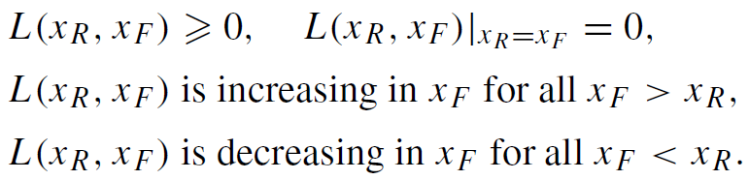
Economic Loss Functions: The Set-Up
The “loss” arising from a forecast x_{F}, when x is realized to be x_{R}, is the loss in utility or profit due to the imperfect prediction
We define the point-forecast/point-realization loss function induced by the decision problem as
  In defining the loss, realized utility is compared to what would have been if the forecast had been the realized value, and not with what utility would be if the realization had been the forecast, U(x_{F}, α(x_{F}))
Therefore there is no reason why L(x_{R}, x_{F}) should necessarily be symmetric in x_{R} and x_{F}
Under our assumptions, the loss function L(x_{R}, x_{F}) satisfies the following properties:

Slide 15
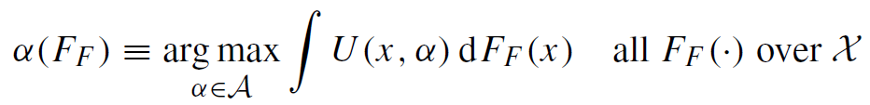
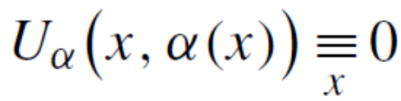
Economic Loss Functions: The Set-Up
These properties generalize in interesting ways to density forecasting, see Granger and Machina (2006)
  Whereas a point forecast x_{F} conveys information on the general “location” of x, it conveys no information as to x’s potential variability
  Forecasters who seek to formally communicate their own extent of uncertainty, or alternatively, who seek to communicate their knowledge of the stochastic mechanism that generates x, would report a distribution forecast FF, e.g., the CFD over the interval X
  A decision maker receiving a distribution forecast, and who seeks to maximize expected utility or expected profits, would have an optimal action function α(·) and loss functions defined by:
For point forecasts, the optimal action function α(·) satisfies the first-order conditions:

Slide 16

The Recovery Problem
The standard, rationality properties of loss functions impose restrictions on the structure of the underlying loss functions
In practice, loss functions are typically not derived from an under-lying decision problem, but rather are postulated exogenously
Because decision-based loss functions inherit certain necessary properties, it is worth asking precisely when a given loss function (or functional form) can or cannot be viewed as being derived from an underlying decision problem
  When they can, it is then worth asking about the restrictions this loss function implies about the underlying utility function or constraints
  When they cannot, one wonders of the rationality of decision-makers
Granger and Machina (2006, JoE) demonstrated that for an arbitrary loss function L(·, ·), the class of objective functions that generate L(·, ·) has the following specification:
  for some function f (·): X →R¹ and monotonic function g(·): A → X

Slide 17
The Recovery Problem
The relationship between decision makers’ loss functions and their underlying decision problems is tight but far from unique
  This theorem states that an objective function U(x,α) and choice space A are consistent with the loss L(x_{R}, x_{F}) if and only if they can be obtained from the function − L(x_{R}, x_{F}) by one or both of the two types of transformations (called “inessential”)
  These consist of either transforming the action monotonically or of adding some quantity f(x) that does not depend on the optimal action
Therefore the relationship between decision makers’ loss functions and their underlying decision problems is tight but far from unique
The most frequently used loss function in statistics is unquestio-nably the squared-error form:
which satisfies standard properties
It must be that for an arbitrary squared-error function with k > 0, an objective function U(·, ·): X × A →R¹ with strictly monotonic optimal action α(·) will generate L_{Sq}(·, ·) as its loss iff:

Slide 18

The Recovery Problem: the Odd Case of Ms. Quadratic
The utility functions recoverable from standard quadratic loss functions are rather unusual and have odd properties
  for some function f (·): X → R¹ and monotonic function g(·): A → X
Utility functions of this form are not particularly standard!
One property is that changes in the level of the choice variable α do not affect the curvature (i.e. the second and higher order derivatives) of U(x, α) with respect to x, but only lead to uniform changes in the level and slope with respect to x
  For any pair of values α₁, α₂ ∈ A, the difference U(x, α₁) − U(x, α₂) is an affine function of x:
Another disturbing property is revealed by the canonical form of the utility function that leads to a squared loss:

Slide 19
The Recovery Problem: the Odd Case of Ms. Quadratic
  E.g., this implies that when a firm faces a realized output price of x, its shortfall from optimal profits due to having planned for an output price of x_{F} only depends upon the difference between x and x_{F} (their square), and not upon how high or how low the two values are
  Thus, the profit shortfall from having underpredicted a realized output price of $10 by one dollar is the same as the profit shortfall from having underpredicted a realized price of $2 by one dollar
  This is clearly unrealistic in any decision problem which exhibits “wealth effects” or “location effects” in the uncertain variable
  E.g., as a firm could make money if the realized output price was $7, but would want to shut down if the realized output price was only $4 (in which case there would be no profit loss at all from having underpredicted the price by $1)
One argument for the squared-error form is that if the forecast errors x_{R} - x_{F} are not too big then this functional form is the natural second-order approximation to any smooth loss function that exhibits the necessary properties stated earlier
However, this argument is fallacious

Slide 20
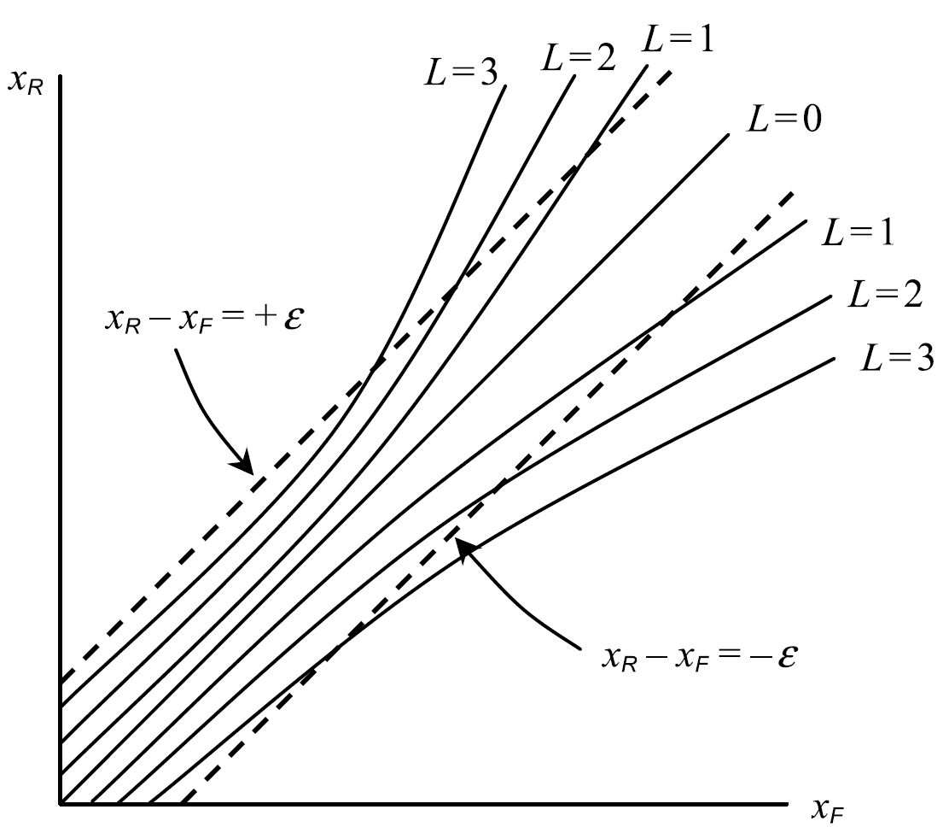
The Recovery Problem: the Odd Case of Ms. Quadratic
  The figure shows the level
  curves of some smooth loss
  L(x_{R}, x_{F}), along with the region
  where |x_{R} - x_{F}|  some small ,
  a constant-width band about
  the 45° line
  This region does not constitute
  a small neighborhood in R²,
  even as  → 0
  The 2nd order approximation
  to L(x_{R}, x_{F}) when x_{R} and x_{F} are
  both small and approximately
  equal to each other is not the
  same as the 2nd order
  approximation to L(x_{R}, x_{F}) when x_{R} and x_{F} are both large
  Legitimate 2nd approx. can only be taken in over small neighborhoods of points in R², and not over bands (even narrow bands about the 45◦ line
  The “quadratic approximation” L_{Sq}(x_{R}, x_{F}) ≡ k (x_{R} - x_{F})² over such bands is not justified by Taylor’s theorem

